Slide 1

Exploratory Data Analysis (EDA)
Data-wrangling with the ANZ Transaction Data-set
By: Naman Sood

Slide 2
Introduction
This presentation will aim to highlight several key points observed throughout the data analysis pipelining of the ANZ-transaction dataset.
It will cover many of the key observations in brief. These include bar-charts, scatter plots, histograms, heatmaps etc.
This whole pipeline was built through Anaconda-jupyter. The main libraries used for this process are pandas, matplotlib and seaborn.
For a much more detailed analysis with all the graphs and observations noted throughout the process, I have uploaded another document which is the HTML format of my Jupyter notebook used for acquiring, cleaning and visualizing the complete data-set. That document contains many more graphs and observations that may be fruitful from a different perspective.

Slide 3

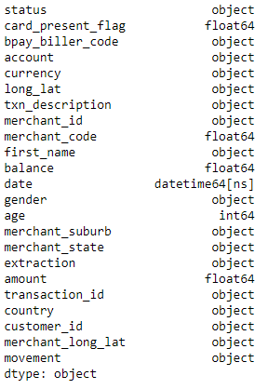
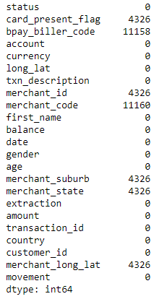
Introduction to the data-set
Data format of each column
The data-set contains 12,043 records with 23 features.
Total transaction amount - 2263284.2
The data-types of amount, age, balance, merchant_code and card_present_flag are numerical which will help us for further graphical analysis. The data-type of column date signifies we can break it down into intervals for further analysis
Frequency of missing values in each column
Missing Data (null values)
There are similar missing values in card_present_flag, merchant_id, merchant_state and merchant_suburb. This implies that there are recorded transactions with UNRECORDED MERCHANTS in unrecorded location. This should be resolved for security reasons.
The huge number of missing values in the merchant_code and bpay_biller_code imply that we can ignore them for further analysis due to lack of data.

Slide 4
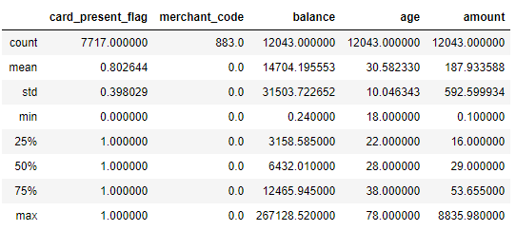
Brief Summary Statistics of numerical values
Summary statistics of the numerical values in the data-set
We draw key-insights through this table:
The average transaction amount is 187.933.
The average age of the customer is 30 years. The lowest is 18 which follows the general guidelines of real-world transactions being performed by adults.
The maximum transaction has been done for 8,835 AUD while the minimum has been for 0.1 AUD. This shows that the transactions are very flexible in nature.
The merchant_code columns only consists of NULL/0 values.
The average balance of a customer is 14,704 AUD. This implies that the average customer is well-off.

Slide 5
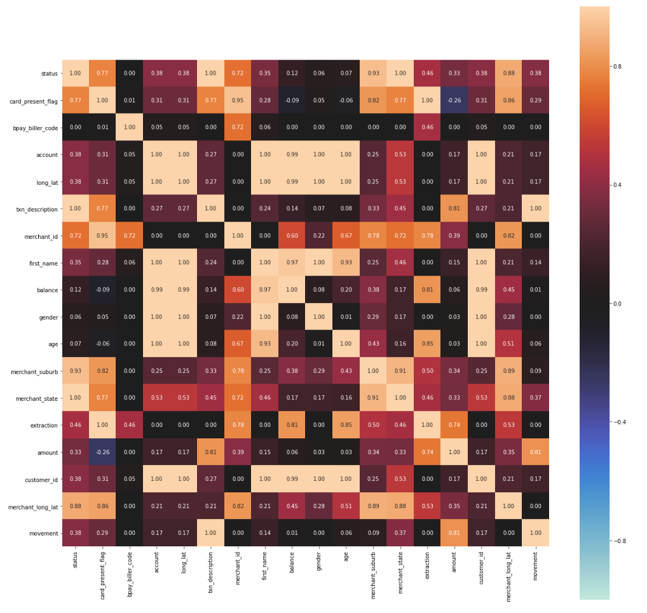
Summary statistics of the nuerical values in the data-set
Correlation between columns.
We observe many things from this heatmap:
Customer_id with merchant_id, merchant_suburb and merchant_state do not correlate very positively. This implies a lack of CUSTOMER LOYALTY or CUSTOMER MOVEMENT as the customers switch between merchants in different areas.
There is positive correlation between amount, merchant_state and merchant_suburb which correlates with more affluent region customers and merchants partaking in much larger transactions.
High correlation between merchant_id and merchant_suburb indicate that the merchants are stationary.
Transaction amount is highly dependent on the type of transaction(txn_description) and method(movement)

Slide 6
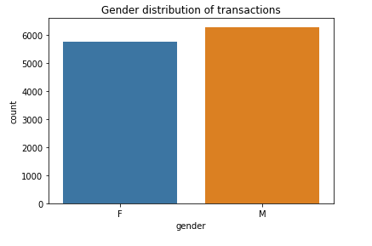
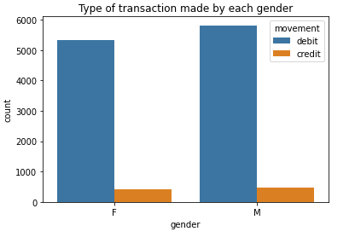
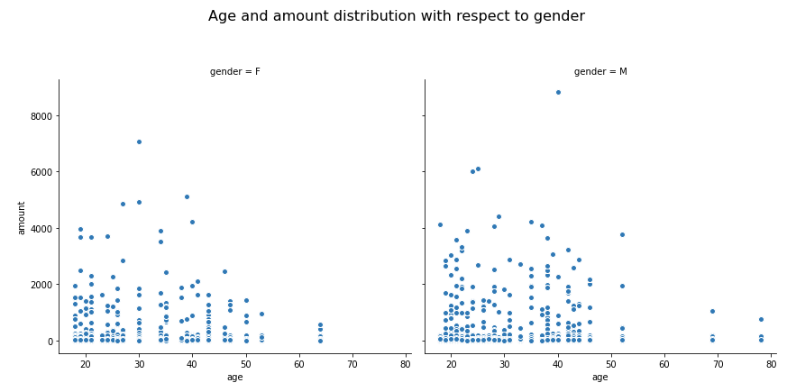
Trends of amount with gender
Gender distribution compared to amount
Comparing the amount with gender to gain some relation insights.
There are almost equal transactions consisting of both of the genders. The transactions are not skewed to support a particular gender.
Both of the genders partake in similar ratio of debit and credit transactions.
There are many more OUTLIERS in the male category for transaction amount and age.
The majority of the demographic involved in these transactions are between the ages of 18-30. Young adults to middle-aged men comprise of the majority of transactions with some outliers even ranging to the ages of 70-80.

Slide 7
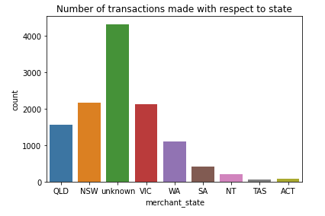
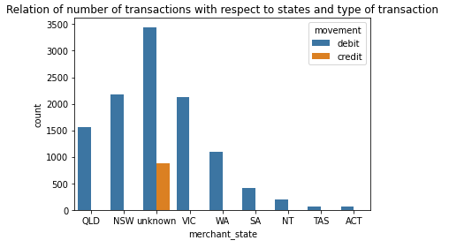
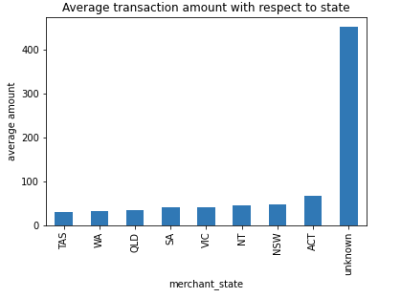
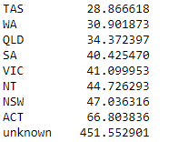
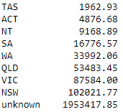
Trends of amount with region
Relation between state and amount
As we do not know the locations of the transactions with missing location, we will map them as UNKNOWN. Observations recorded through mapping the relation:
The unknown/unrecorded region has undergone the highest number of transactions.
The average transaction value in the unrecorded states are far greater than any of the recorded ones (manifold times).
Only the unrecorded regions have credit transactions. Credit transactions make up for the bulk of the total transaction amount.
All of this indicates that the biggest contributors to the data-set are from the unrecorded regions. Those regions are the key-factor of this data-set and the corresponding organization as a whole.
Average(left) and total(right) transaction amount per state

Slide 8
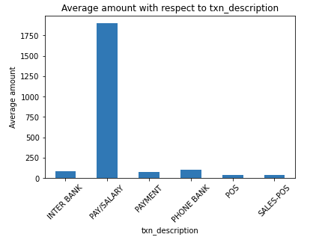
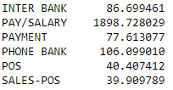
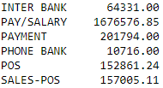
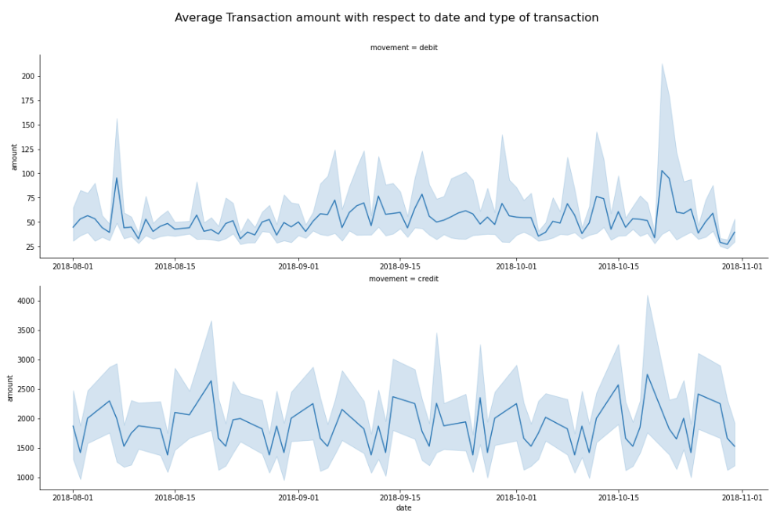
Average(left) and total(right) amount with respect to description
Taxation description and time series plot-1
Observations recorded through mapping the relation:
PAY/SALARY is the major contributor of the transactions performed. This is a common occurrence as salaries are the main transaction statements in organizations.
We map the average transaction amount throughout the given time period along with their confidence interval. We observe that the credit transactions are much more expensive (which explains the movement-amount correlation).
The transaction amounts do not have a set pattern. They have unpredictable steep inclines and declines throughout the time period.
The debit transactions are much less spread out compared to the credit transactions.

Slide 9
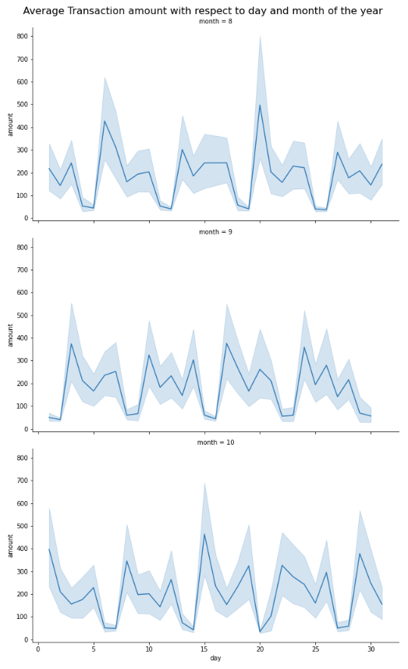

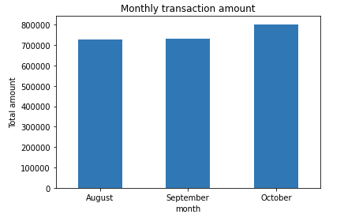
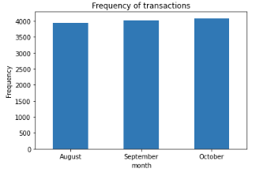
Monthly total transaction amount
With month number
Time Series – 2 and monthly mapping
Observations recorded through mapping the relation:
The months follow similar upwards and downwards trends for the average transaction amount.
The start and end of the month usually end up close in terms of transactions.
There has been an increase in the number of transactions as well as the total amount corresponding to those transactions.
Increase of 0.08% going from the month of August to September
Increase of 9.89% going from the month of September to October

Slide 10
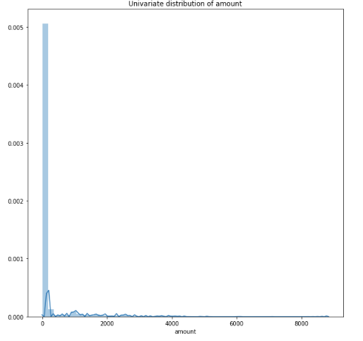
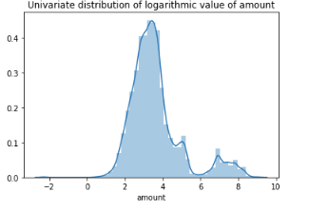
Cleaning amount data
The elementary amount data(left) is extremely skewed to the right and we cannot visualize any outliers. A normal distribution is always preferred for predictions as well as analysis.
Taking the logarithmic value of amount will give us such a graph(right).
Outliers in age and amount
OUTLIER DETECTION ALGORITHM
We are considering outliers as values that lie uotside 3 standard deviations from the mean
Number of outliers detected
Age – 224 values are outliers
Amount – 327 values are outliers
Procedure and result in the HTML documentation

Slide 11
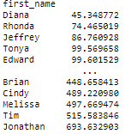
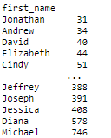
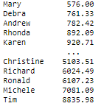
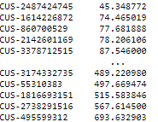
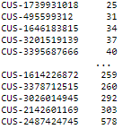
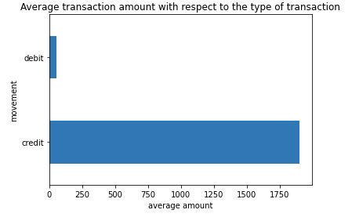
Average(left), number of transactions(middle) and maximum transaction(right) performed with respect to first_name in ascending order
Miscellaneous Key points
Observations from mapping these values are as follows:
The most number of transactions performed are by Michael. Many of the high frequency transaction customers do not have customer IDs (their frequency does not reflect in any of the rows in customer_ID)
The highest transaction recorded with respect to the first name is Tim. The transaction made is also the highest in the whole dataset.
There is AN INVERSE RELATION between the average amount of transaction and the number of transactions made.
Debit transaction amount - 586707.35
Credit transaction amount - 1676576.85
Average(left) and number of transactions(right) performed with respect to customer_id in ascending order

Slide 12
Thank You for your time
Further analysis and key-notes present in the HTML document

